Slide 1
Facebook Comment Volume Prediction
Dimitrije Adzic
Behzad Pouyanfar
Group 3

Slide 2


Data Source: https://archive.ics.uci.edu/ml/datasets/Facebook+Comment+Volume+Dataset
Paper: https://ijssst.info/Vol-16/No-5/paper16.pdf
The increasing use of social networking services had drawn the public attention explosively from last 15 years
The merging up of physical things with the social networking services had enabled the conversion of routine objects into information appliances
These services are acting like a multi-tool with daily applications like: advertisement, news, communication, banking, commenting, marketing
These all services have one thing in common that is daily huge content generation, that is more likely to be stored on hadoop clusters. As in Facebook, 500+ terabytes of new data ingested into the databases every day, 100+ petabytes of disk space in one of FB’s largest Hadoop (HDFS) clusters and there is 2.5 billion content items shared per day
Methods that we will be using are: Ridge, Lasso, Elastic Net, Random Forest (500-trees)
There are 40949 observations with 54 features. Our response variable is number of comments in a facebook post

Slide 3
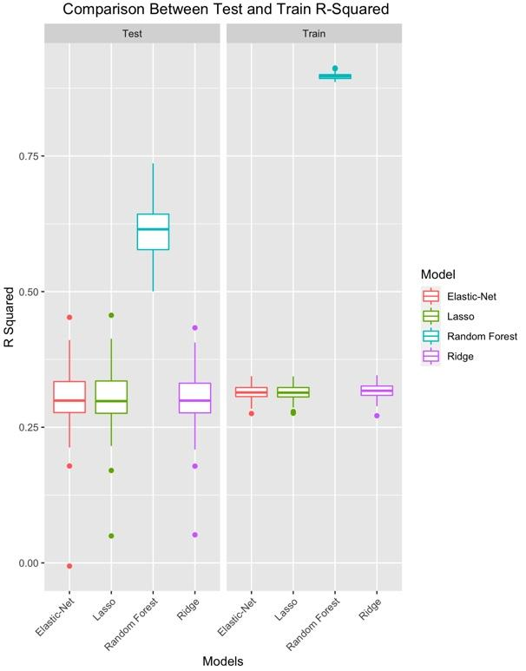
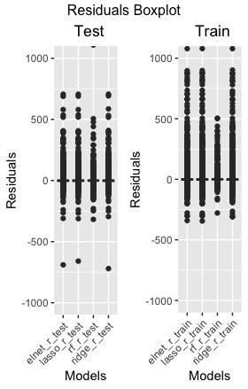
Boxplots of 100 Simulations
for Test and Train
 | Train R² (Avg) | Test R² (Avg)
Ridge | 0.3166 | 0.3004
Lasso | 0.3141 | 0.3015
Elastic Net | 0.3144 | 0.3015
Random Forest | 0.8967 | 0.6117

Slide 4
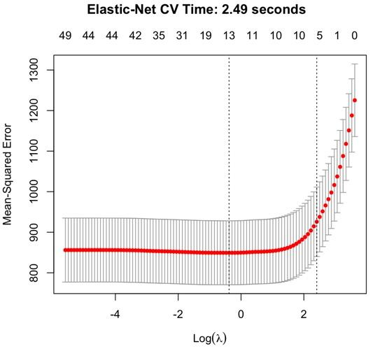
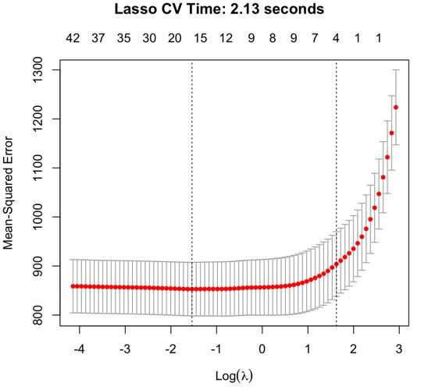
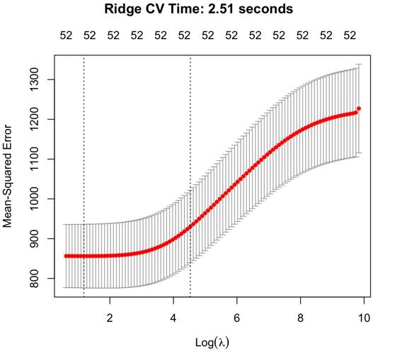
Cross-Validation Curves

Slide 5
Test R-Squared Confidence Interval and Time
 | Test R-Squared Lower Bound For 90% confidence interval | Test R-Squared Upper Bound For 90% confidence interval | CV Time (Average) | Single Fitting Time (Average)
Ridge | 0.2982 | 0.3026 | 1.76 seconds | 0.1421 seconds
Lasso | 0.2993 | 0.3038 | 1.66 seconds | 0.1394 seconds
Elastic-Net | 0.2994 | 0.3037 | 1.69 seconds | 0.1243 seconds
Random Forest | 0.6108 | 0.6126 | NA | 9.0020 minutes

Slide 6
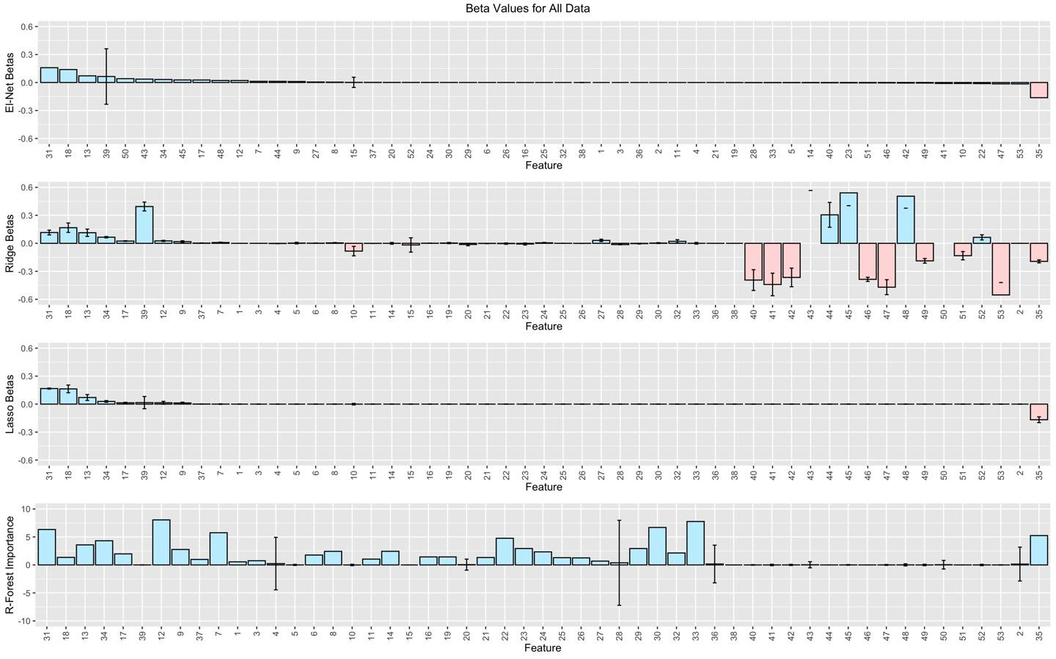
Coefficients
Elastic-Net and Lasso agree more or less on coefficients while Ridge includes more variables
Random Forest with
mtry =7
ntree =500

Slide 7
To Conclude:
Our results for this specific dataset shows that Random Forest does a significantly better job than linear models. However, it takes much longer.
It is possible that for different data points the gap between R-Squared in linear models versus Random forest would be smaller. In this scenario it justifies using a linear model which takes significantly less time.

